Slide 1
Core-Java Project
Name :- Virendra Chaure
Employee Id :- 194537

Slide 2
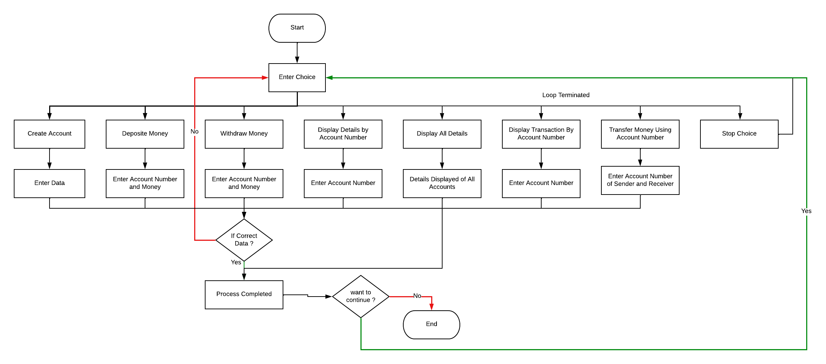
Flowchart

Slide 3
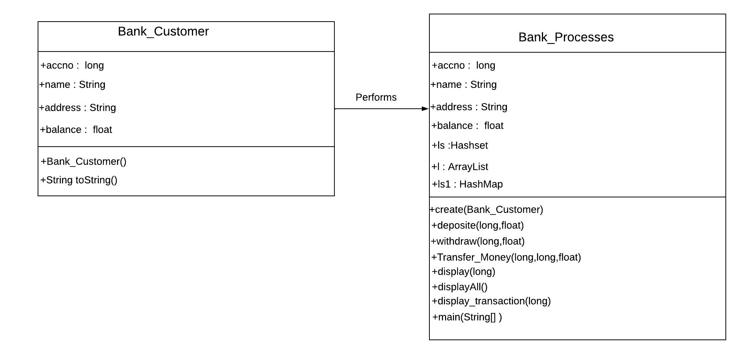
Class Diagram

Slide 4
Thank You…!!! Any Questions ?

